Slide 1
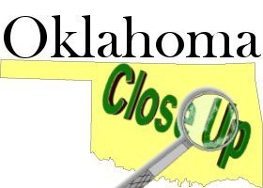
Oklahoma Close-Up
Giving students a “Close-Up” look at Oklahoma state government since 1980.
Notes:
Close-Up logo overlapping the red.

Slide 2
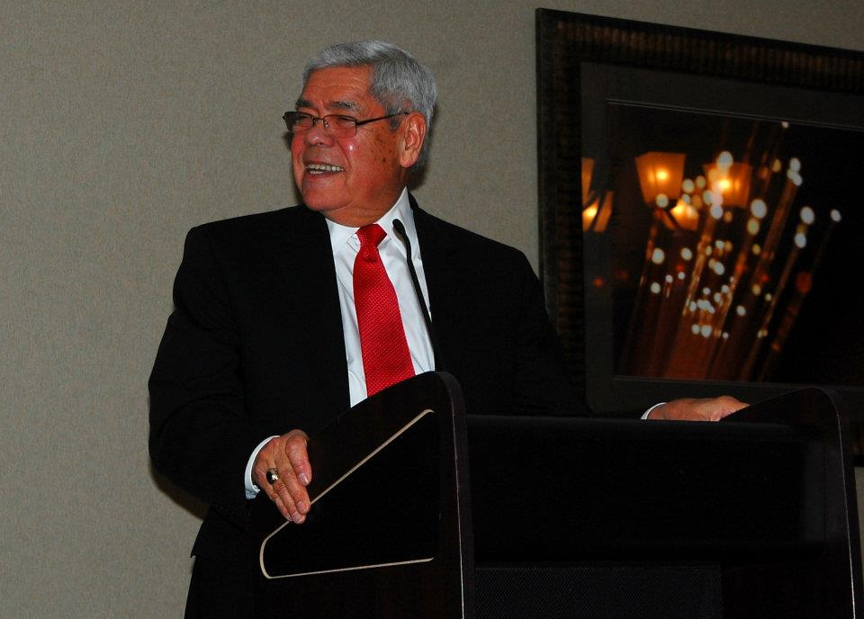
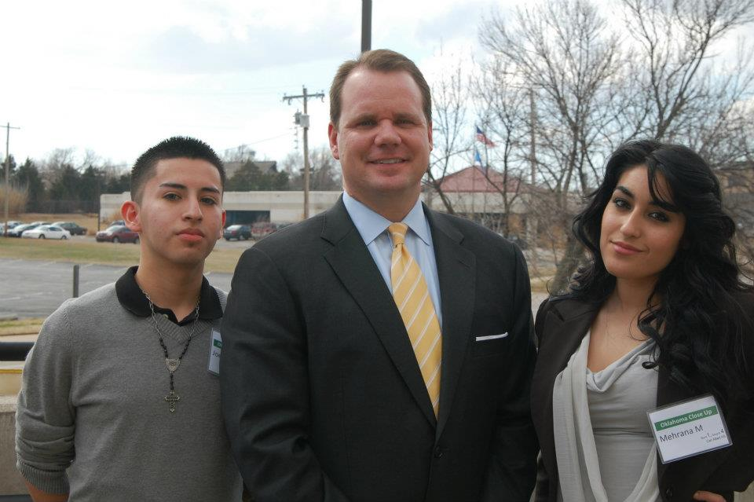
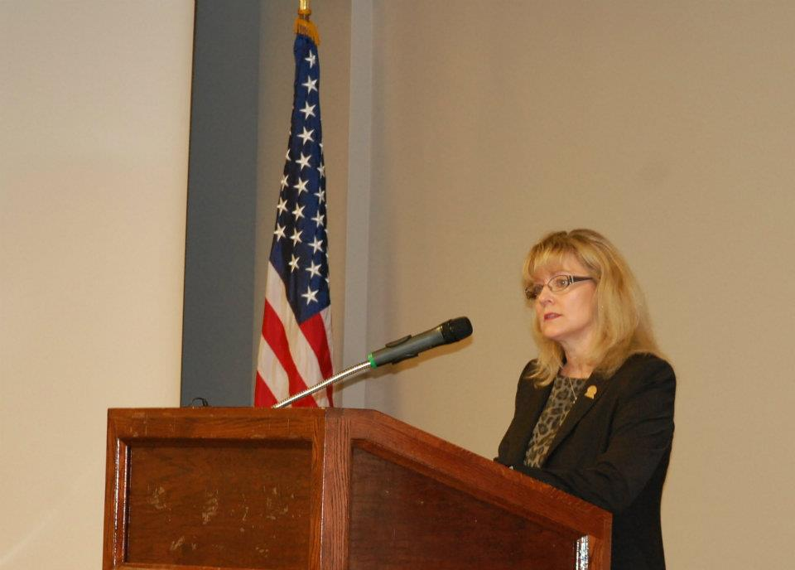
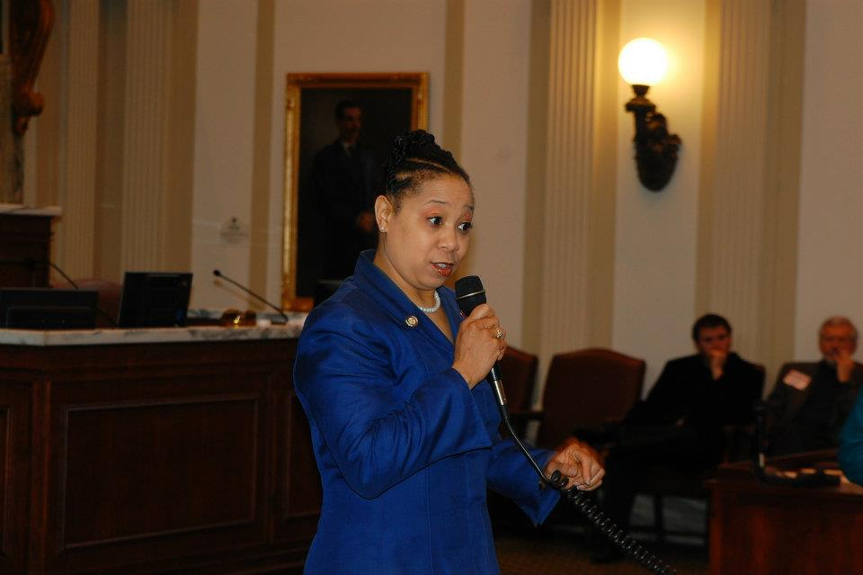
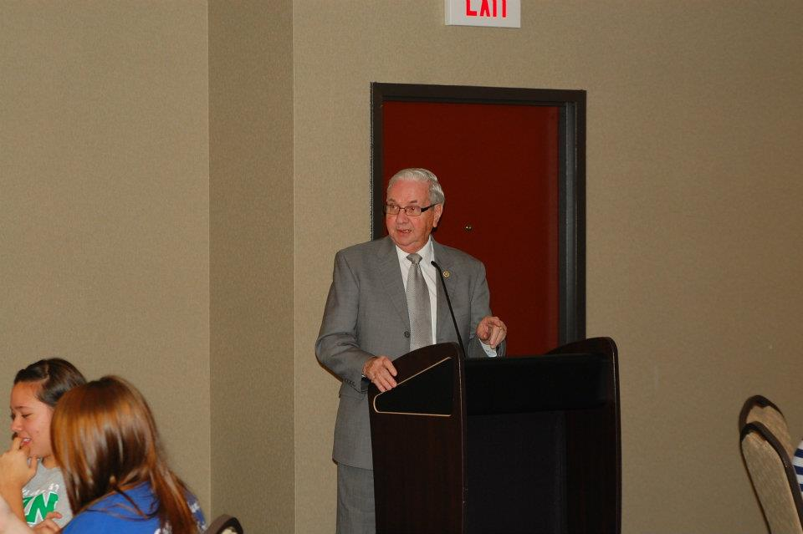
Presenters
Above: Neal Mccaleb, former state
legislator and cabinet member in
the G.W. Bush Administration
Above: Students with Lieutenant Governor Todd Lamb
Above: Corporation Commissioner
Patrice Douglas
Left: Frost Troy. Founding editor of
the Oklahoma Observer.
Above: Representative Anastasia Pittman

Slide 3
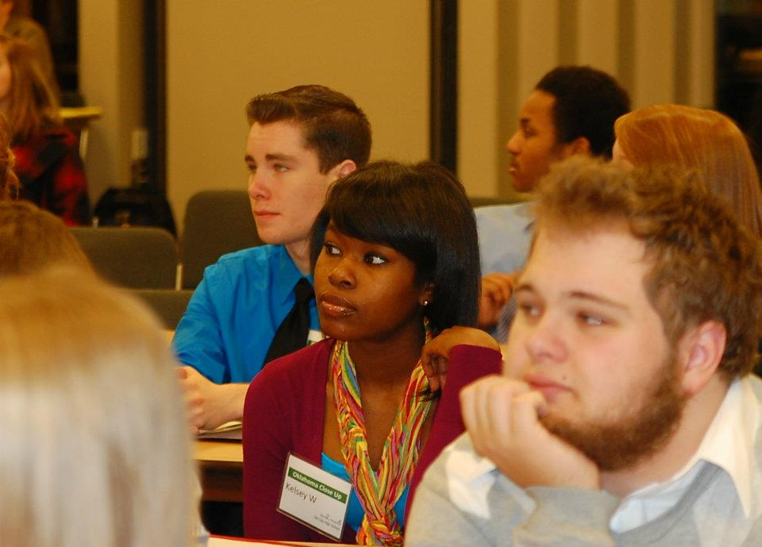
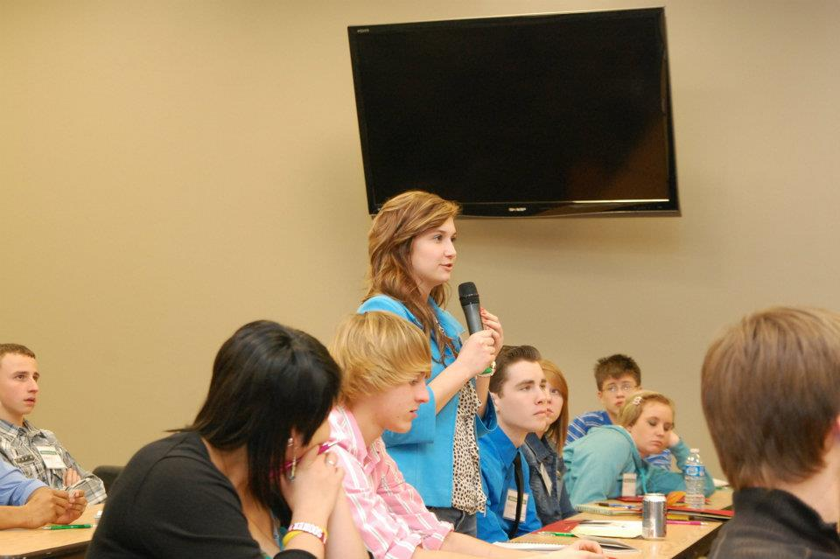
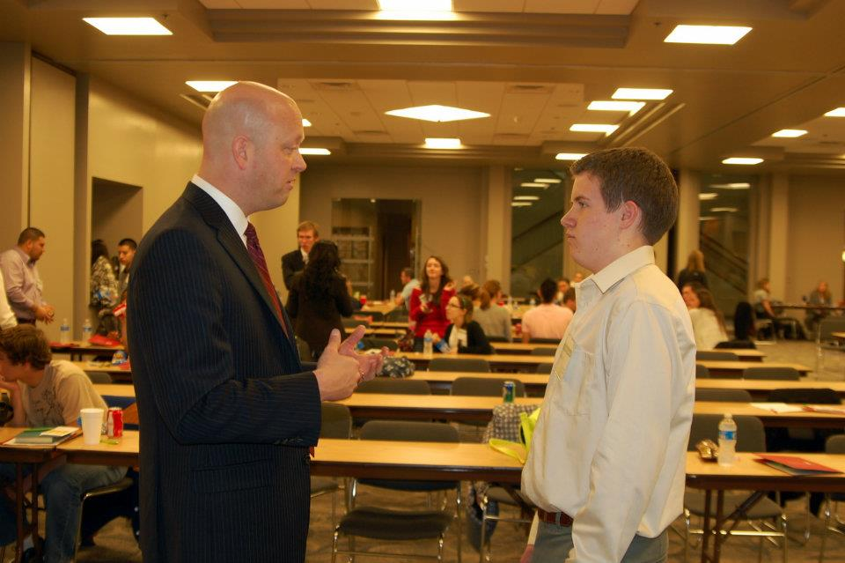
Student Learning
Much of the program occurs at the Oklahoma Bar Center. This is great forum for presentations, questions, and conversation with people of great influence in Oklahoma politics.

Slide 4
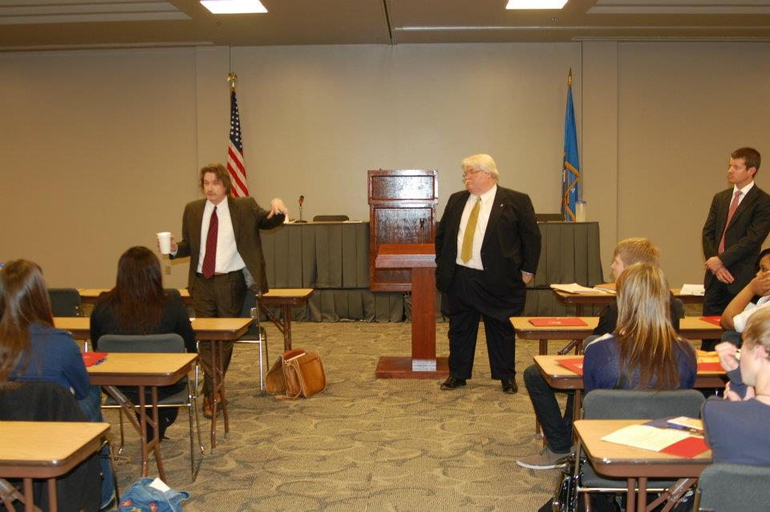
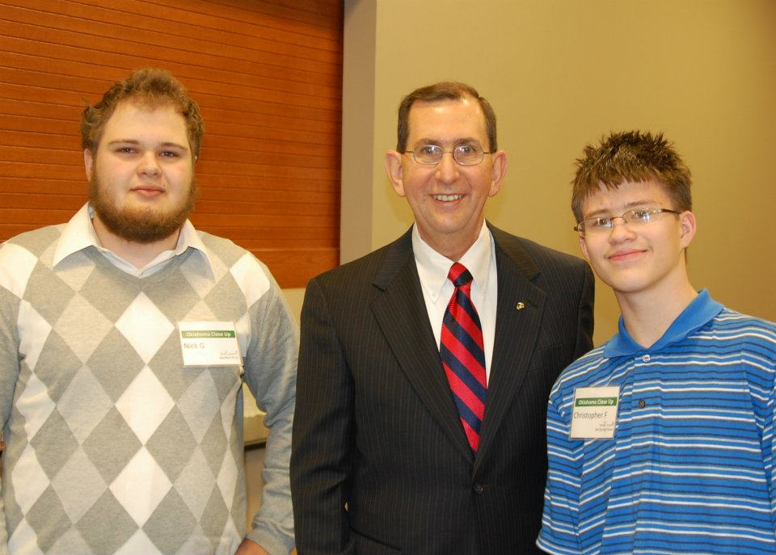
Oklahoma Court of Criminal Appeals
Once a year the Oklahoma Court of Criminal Appeals, one of the 2 courts of last resort in Oklahoma, moves their courtroom to the Bar Center for Oklahoma Close-Up.
Above: The lawyers answer questions for the
students as we await the decision.
Left: Justice Lumpkin at lunch with our students

Slide 5
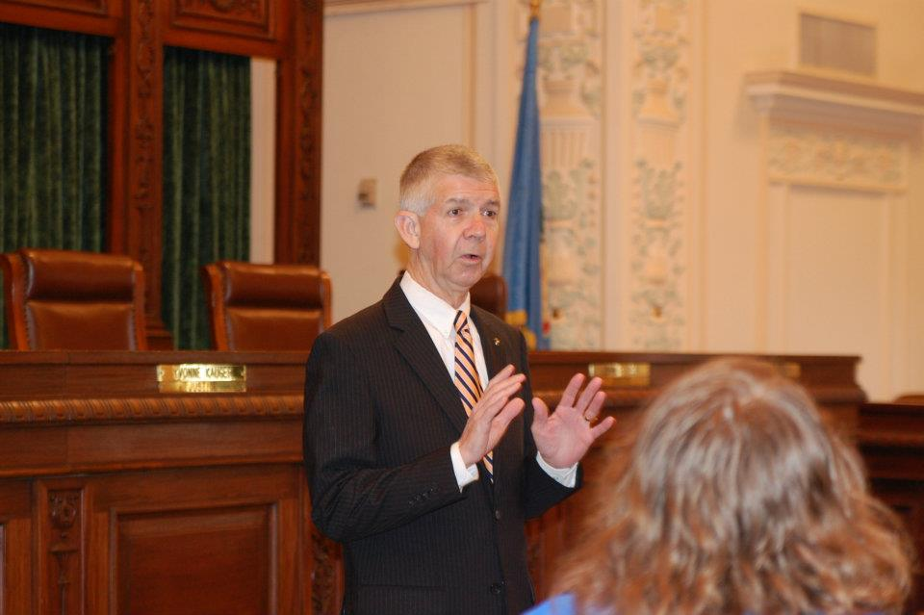
Student Presenters
Students introduce every speaker to the group. This presenter introduced Oklahoma Supreme Court Chief Justice Steven Taylor in the Supreme Court Chambers.

Slide 6
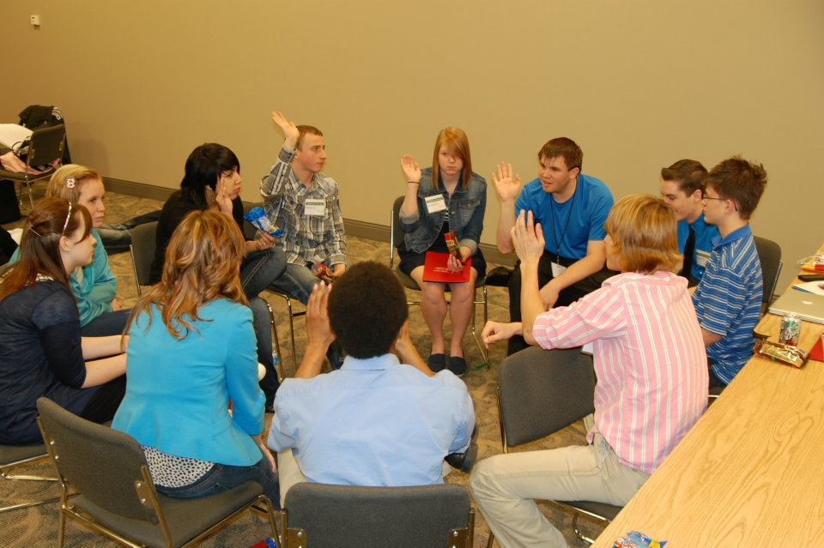
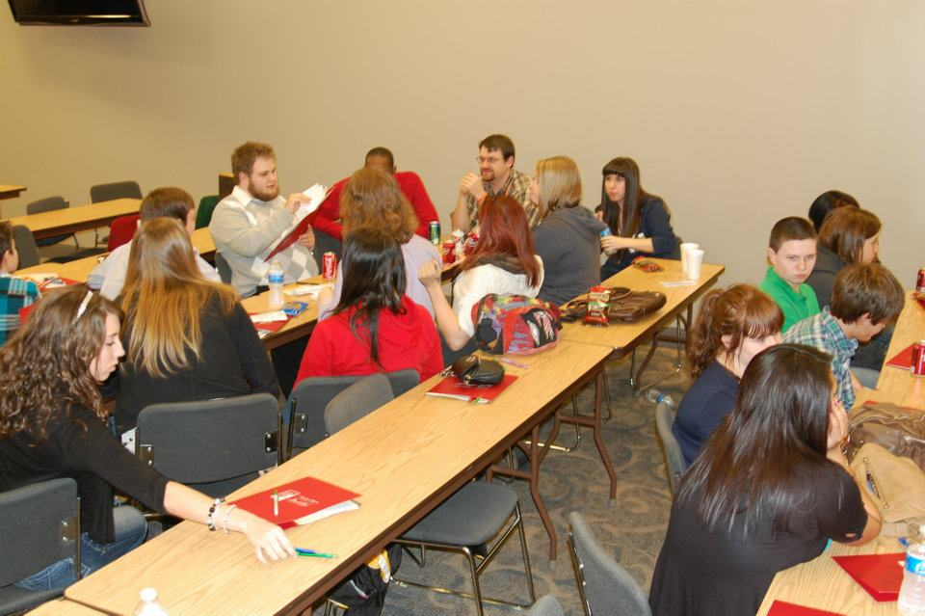
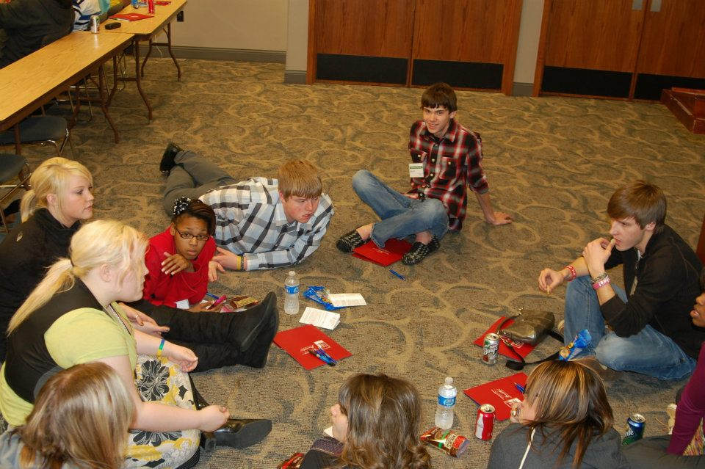
Small Groups
In small groups, our Program Instructors (P.I.s) and their students discuss speakers, issues or plan for events such as mock legislature.

Slide 7
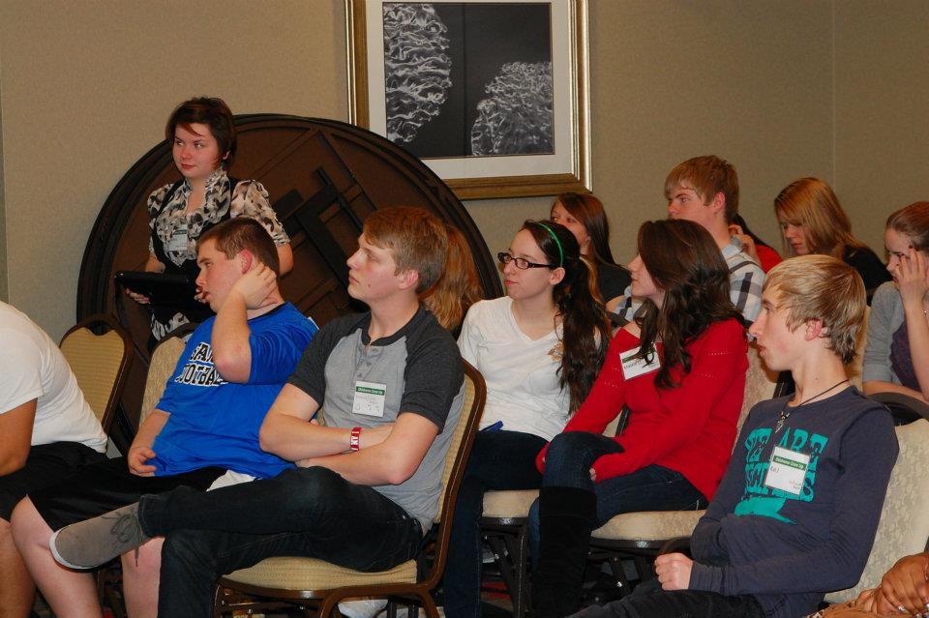
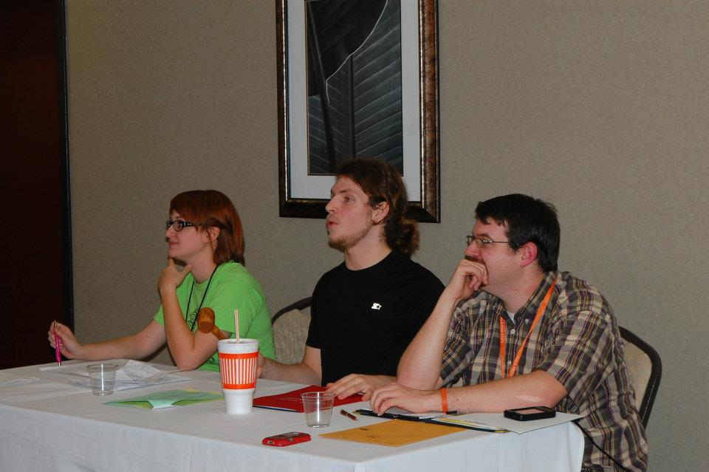
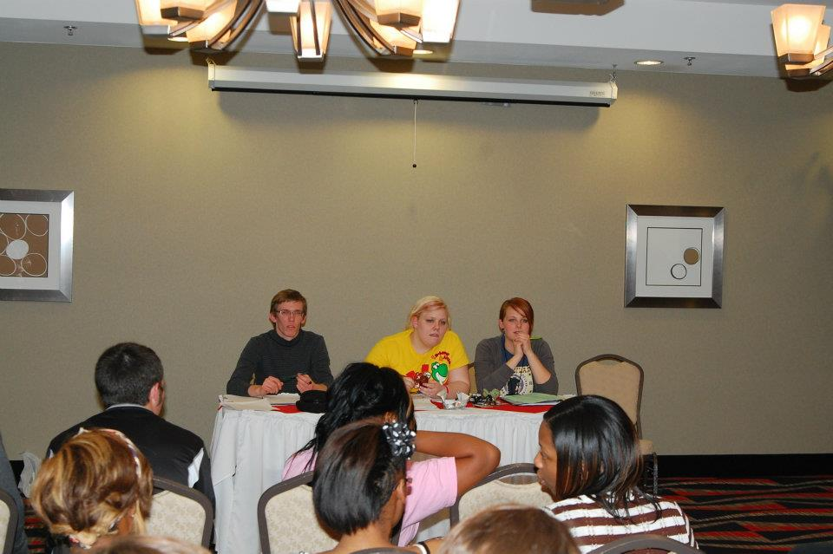
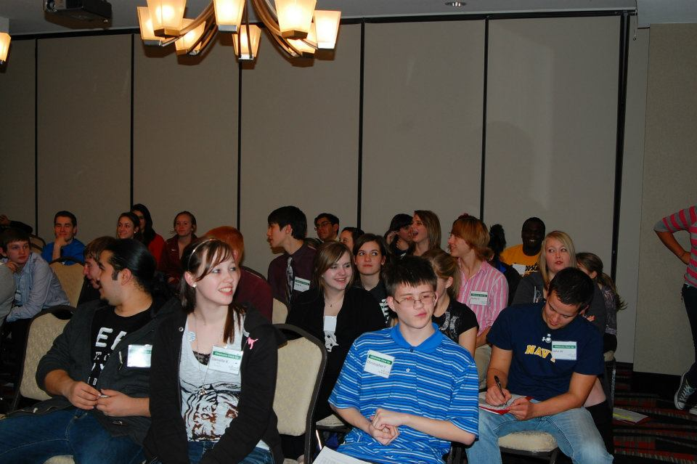
Mock Legislature
Can you get your bill passed?

Slide 8
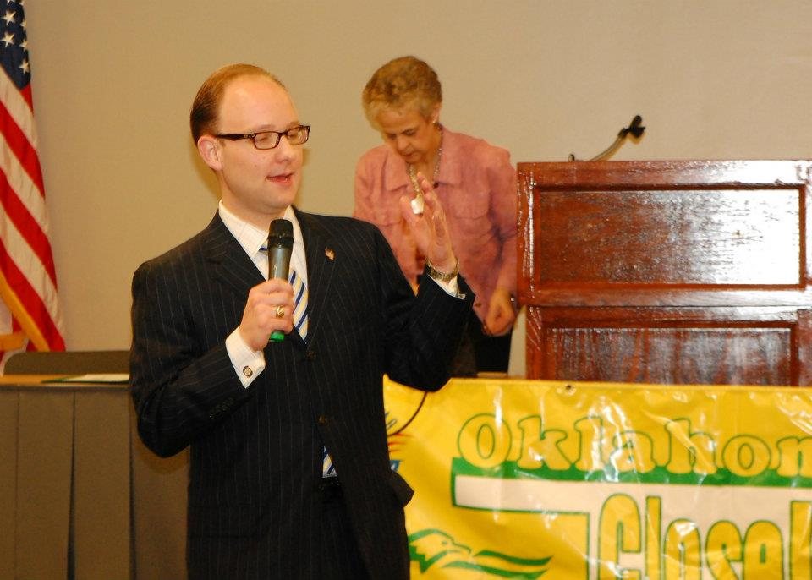
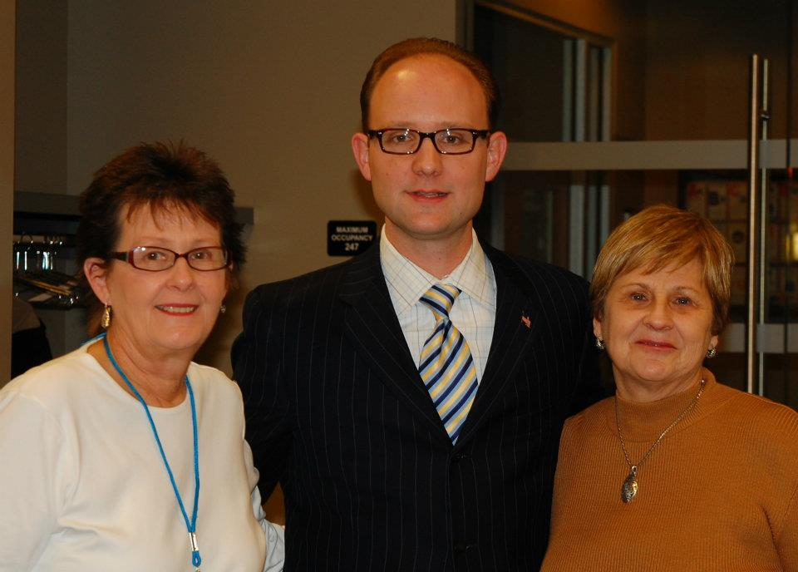
House of Representatives Minority Leader Scott Inman
Representative Inman is a former student and program instructor for Oklahoma Close-Up. He speaks annually.

Slide 9
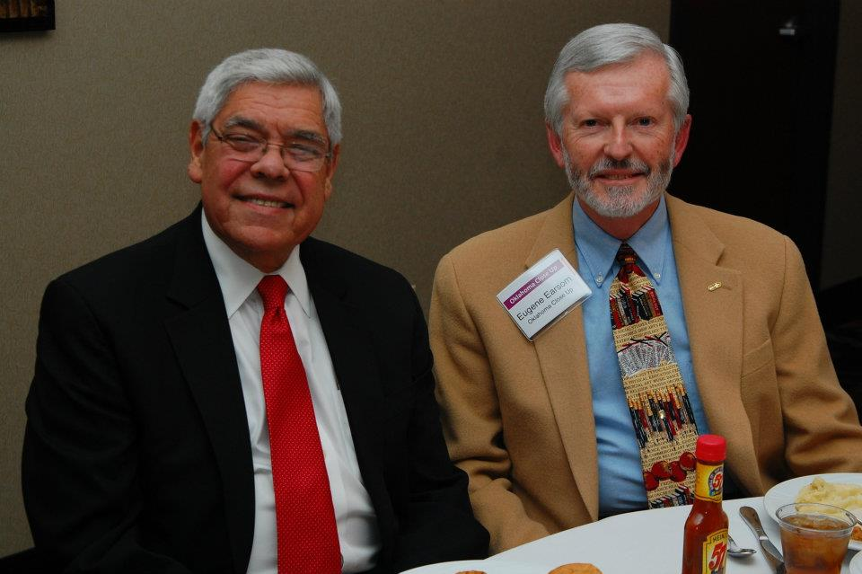
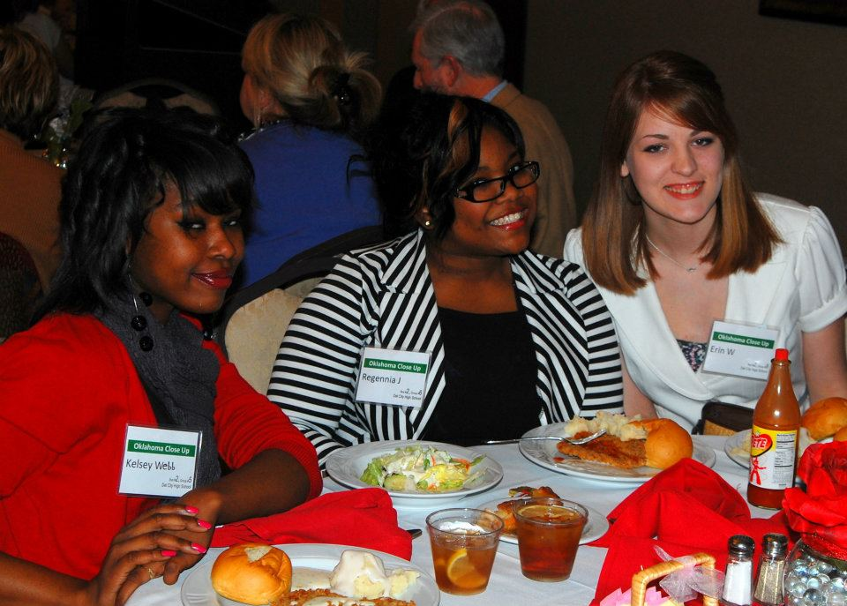
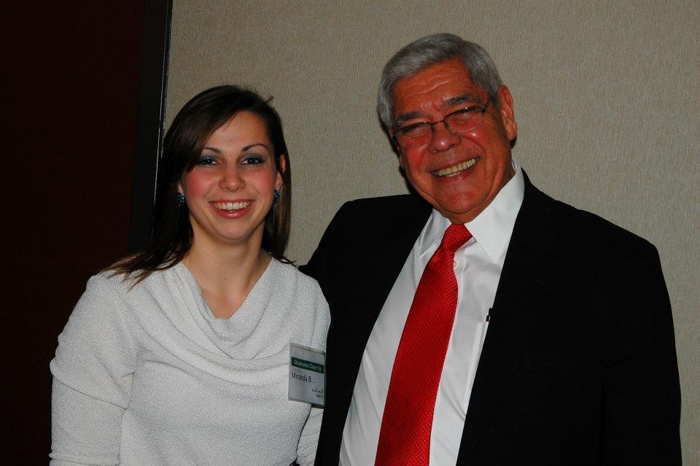
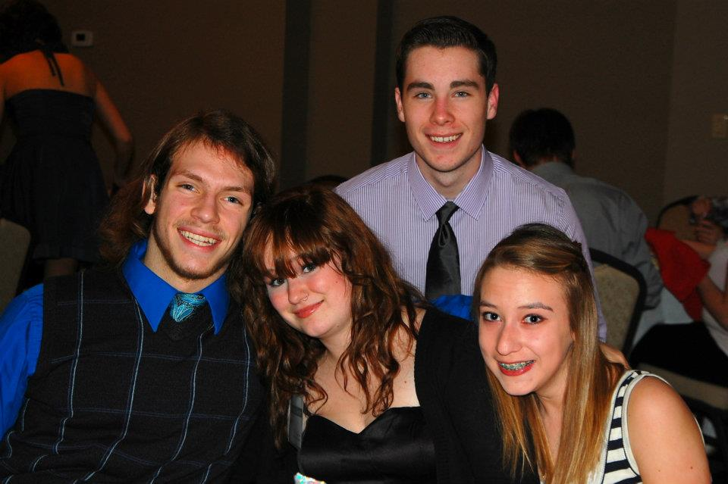
Banquet
The 2012 keynote speaker was former Oklahoma House of Representative Minority Leader Neal McCaleb. Mr. McCaleb served in the Keating and Bellmon Administrations. He also served as Assistant Secretary of the Interior for Indian Affairs in the George W. Bush Administration. Currently, Mr. McCaleb serves work for the Chickasaw Nation developing long-term economic plans.

